Slide 1
Designing for Change
Tight Coupling

Slide 2
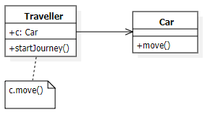
What is tight coupling
Tight coupling is when a group of classes are highly dependent on one another.
This scenario arises when a class assumes too many responsibilities, or when one concern is spread over many classes rather than having its own class.

Slide 3
Problems of tight coupling
Classes that are tightly coupled are hard to reuse in isolation
Leads to monolithic system, where you can’t change or remove a class without understanding and changing many other classes
The system becomes a dense mass that’s hard to learn, port, and maintain.

Slide 4

Loose coupling
Loose coupling is achieved by means of design that promotes single-responsibility and separation of concerns.
A loosely-coupled class can be consumed and tested independently of other (concrete) classes.
The Hat is "loosely coupled" to the body. This means you can easily take the hat off without making any changes to the person/body. When you can do that then you have "loose coupling"

Slide 5
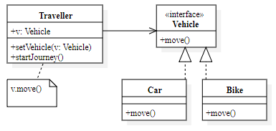
What is tight coupling
Increases the probability that a class can be reused by itself.
A system can be learned, ported, modified and extended more easily.

Slide 6
Why important
It’s important because software changes all the time. Generally speaking you want to be able to easily modify your code.

Slide 7
Design Patterns
Design patterns use techniques such as abstract coupling and layering to promote loosely coupled system.
Abstract Factory, Observer

